Slide 1
H-1B ELECTRONIC REGISTRATION PROCESS
USCIS
February 23, 2023
Notes:
Good afternoon everyone.
Welcome to the U.S. Citizenship and Immigration Services (USCIS) national engagement on the FY 2024 H-1B Electronic Registration Process.
We have a detailed presentation lined up for you today, but before we get started, I would like to provide some quick administrative reminders.
NEXT SLIDE
**USCIS owns the images

Slide 2
Administrative Reminders
Today’s presentation is not intended for media attribution.
If you are a member of the media, please reach out to USCIS Office of Public Affairs with any inquiries at media@uscis.dhs.gov.
Any congressional staffers may contact the USCIS Office of Legislative Affairs.
All lines are muted.
Submit written questions through the “Q&A box” on the right side of your screen.
Notes:
As a reminder:
Today’s presentation is not intended for media attribution.
If you are a member of the media, please reach out to USCIS Office of Public Affairs with any inquiries at media@uscis.dhs.gov.
Any congressional staffers may contact the USCIS Office of Legislative Affairs.
All lines are muted and will remain muted throughout the webinar.
You may submit written questions through the “Q&A box” on the right side of your screen.
NEXT SLIDE

Slide 3

Today’s presentation will cover
USCIS Online Account Creation
Important Reminders
New Features
Key Dates and Information to Remember
Questions and Answers
Notes:
Today we will provide an informational overview of the H-1B electronic registration process in the USCIS online account.
We will review how to create a USCIS Online Account;
Share important reminders about the H-1B registration process;
Talk about new features we have made available for the FY2024 Cap Season;
Review key dates and information for this year’s registration period and notification process; and
Answer your questions.
This is the fourth year we’ve had H-1B online registrations. This is the only engagement we’re hosting on this topic this year, and we will review topics we covered in previous years fairly quickly. If you are new to this, don’t worry. Our slides cover a lot of information about the registration process and will help you to review topics like account creation and account recovery in more detail.
The benefits of the USCIS online account include:
Knowing that you filled out all the required parts of the registration;
Receiving an online confirmation when USCIS receives your registration;
Having the convenience of checking your registrations for duplicate entries, once submitted;
Receiving automatic updates about your registration; and
Paying fees conveniently and securely online.
NEXT SLIDE
USCIS owns the image

Slide 4

Registration Period Timelines
Feb 21, 12 p.m. (Eastern): New H-1B registrant accounts can be created
March 1, 12 p.m. (Eastern): H-1B registration period opens, registrations can be created/submitted
March 17, 12 p.m. (Eastern): H-1B registration period closes, no more registrations can be submitted
March 31: USCIS intends to issue selection notifications through USCIS online account by this date.
April 1: Earliest date that FY24 H-1B cap-subject petitions can be submitted
Notes:
Once again, the registration period is open from March 1 at noon until March 17 at noon.
NEXT SLIDE
**Image obtained from bing.com images, using the filter “Free to modify, share, and use commercially”

Slide 5
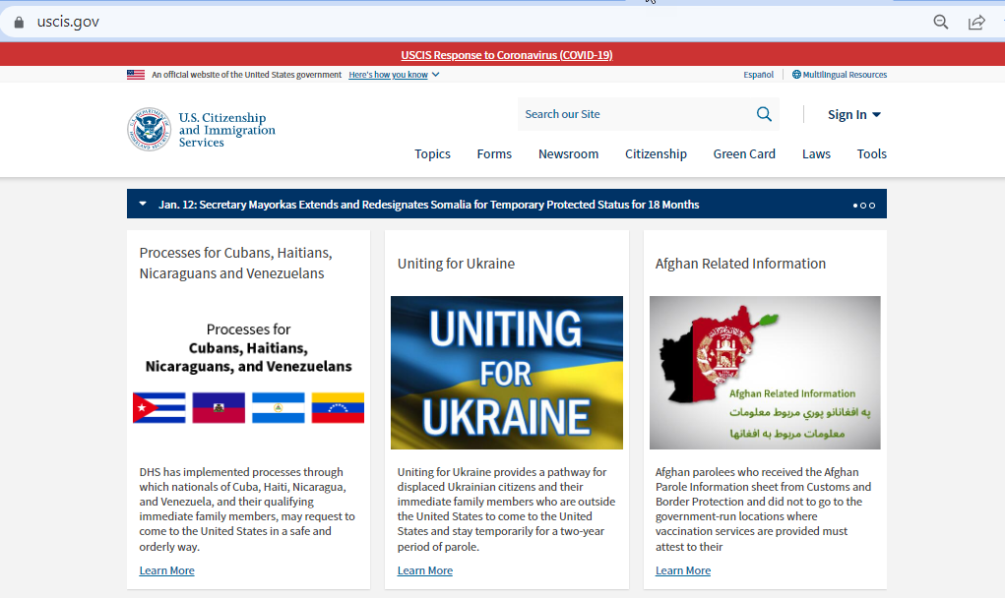
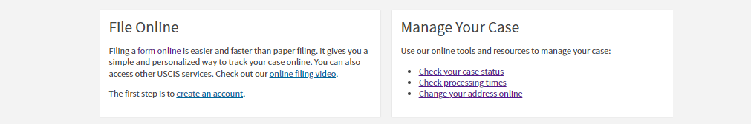
Creating Your USCIS Online Account
Create an account or sign in here:
www.uscis.gov
my.uscis.gov
myaccount.uscis.gov
Notes:
You begin the registration process by signing in to your USCIS online account if you already have one, or creating a new account if you don’t have one. This slide shows where you can sign in or create an account.
Submitting an H-1B registration requires one of two types of USCIS online accounts: a registrant account or a representative account. The appropriate type depends on the submitter’s role:
Representatives and attorneys use the representative account….and they may use their existing account if they have one.
Prospective petitioners, U.S. employers and agents, what we refer to as “registrants”— will use a registrant account.
If you don’t already have a registrant account, you can begin creating one on February 21 at noon ET, ahead of the registration period.
There is a $10 fee to register each H-1B beneficiary for the selection process. USCIS does not charge a fee to sign up for or use the online account.
For the purposes of this presentation, I will sign up as a new user.
NEXT SLIDE **USCIS owns the images

Slide 6
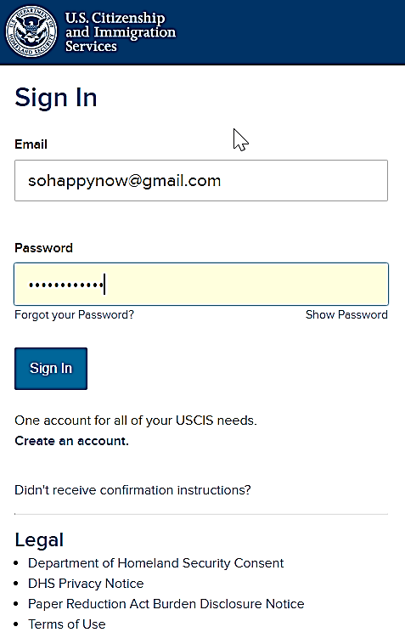
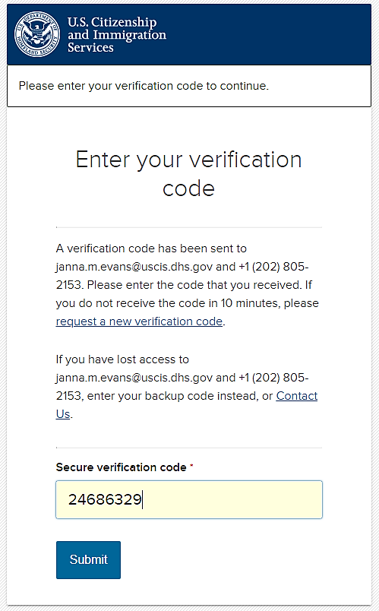
Creating Your USCIS Online Account
Go to my.uscis.gov
Select “Create an account”
Enter email address twice
System will send you a link
Click on link, enter email address & password
System will send one-time PIN via text or email
Enter the PIN
sohappynow@gmail.com
Notes:
This slide reviews how to create an account. We’re not going to spend much time on this. If you have banked or shopped online, you are probably already familiar with the steps. We also require two-factor authentication every time you go into your account. Again, this is a standard security measure.
One thing to remember: every account must have a unique email address. You cannot share your account with other people.
NEXT SLIDE
**USCIS owns the images

Slide 7
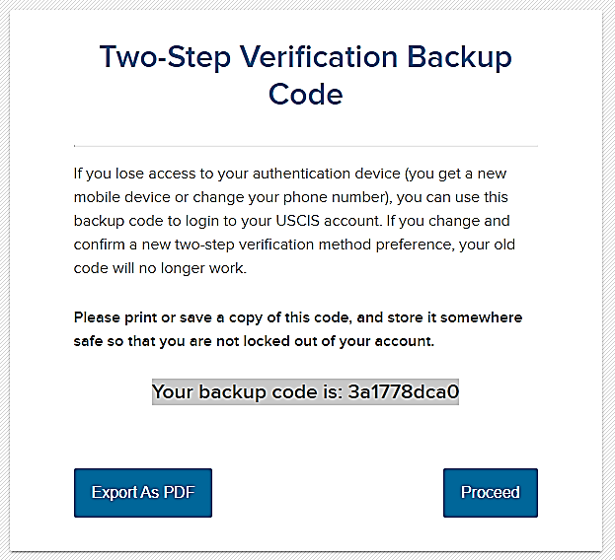
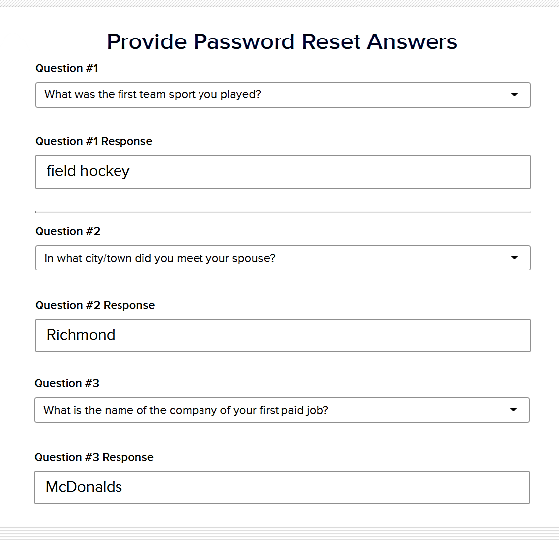

Account Recovery
Save your backup code and password reset answers!
Notes:
When you create your account, you may not really notice these sections, but they are important. When you create your online account, you will be given a backup code. SAVE IT! We suggest you take a picture with your phone or grab a screen shot of it and save it to a folder where you keep all your important account information.
Also, when you first create your account, you will be asked five password reset questions and answers. You should save these too. You will need them if you ever need to reset your password.
NEXT SLIDE
**USCIS owns the images

Slide 8
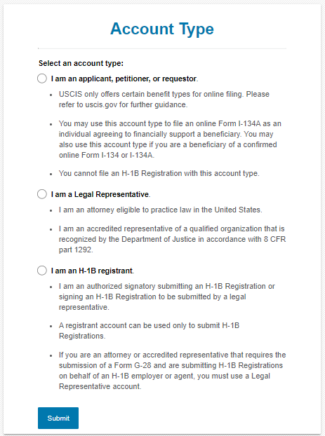
Account Types for H-1B Registration
Do not select “Applicant, Petitioner, or Requestor account” for H-1B registration.
Representative account—Select this if you are a legal representative, and the prospective petitioning entity is your client
H-1B registrant account—Select this if you work for the prospective petitioning company/entity (for example, HR professional or in-house counsel)
DO NOT SELECT APPLICANT/PETITIONER ACCOUNT FOR H-1B REGISTRATION
Notes:
You must choose the correct type of account for H-1B electronic registrations. The appropriate type depends on the submitter’s role. There are two options.
DO NOT choose the applicant, petitioner, or requestor account. You cannot use this type of account to submit an H-1B electronic registration.
If you are a legal representative working on behalf of the prospective petitioning company, you would select the first type of account shown here….“I am a legal representative.”
If you already have a representative account that you used to submit registrations and immigration forms before, you DO NOT NEED to create a new representative account. You can use the same account.
The second type of account that can be used to submit H-1B electronic registrations is a registrant account, shown here Prospective petitioners, submitting registrations on their own, will need to create an “H-1B registrant” account, The H-1B registrant account can also be used by employees or designees of the petitioning company.
Registrant means “the prospective petitioning individual, company, entity, or organization submitting a registration into the selection process, for a beneficiary who is a prospective H-1B nonimmigrant worker.”
Prospective petitioners who are working with a legal representative will also need to create an “H-1B registrant” account, to be able to sign the G-28 and review and approve the registrations entered by the attorney or accredited representative. Registrations created by an attorney or accredited representative will remain “in progress” and will not be submitted to USCIS until the Registrant (who is the “prospective petitioner”) reviews and approves them in their own online account, and then the Legal Representative pays and submits the registrations.
If you already have a Legal Representative or H-1B Registrant account, you can sign into that account when the H-1B registration period is open, from noon Eastern March 1 to noon Eastern March 17, to submit H-1B registrations. You do not need to create a new account for this process.
Please note: you can use an existing account to submit registrations this year, but you cannot re-use beneficiary information from prior cap season registrations. You will need to submit new information for each beneficiary this FY 2024 cap season, even if they were listed in a previous cap season.
For our purposes today, we will choose the H-1B registrant account. This account is only open and visible during cap season each spring. As previously stated, the enrollment period for this year is March 1 @ noon until March 17 @ noon. Again, if you don’t already have an existing account, you can begin creating an account starting this past Tuesday, Feb. 21, ahead of the March 1 registration start date.
NEXT SLIDE
**USCIS owns the images

Slide 9
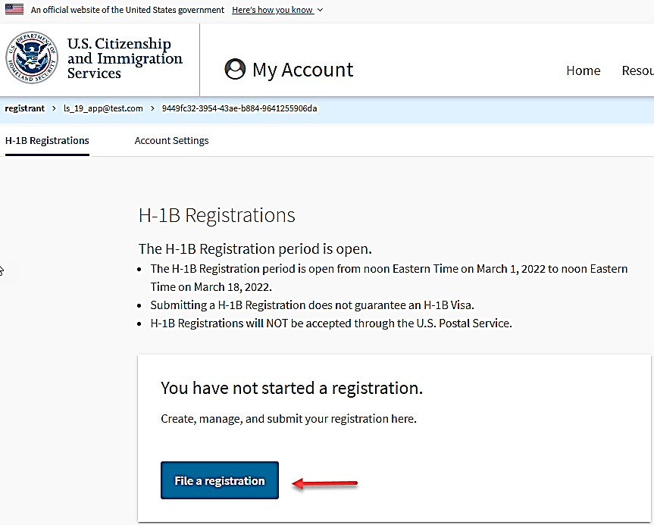
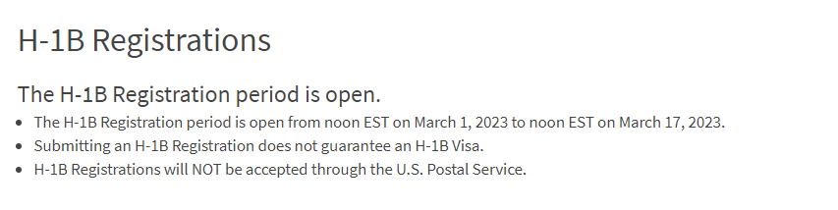
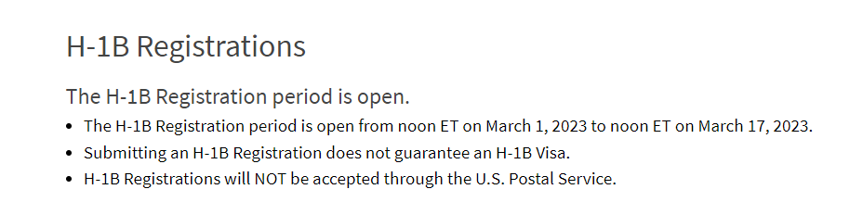
H-1B Electronic Registration
Registering online does not guarantee selection
We do not accept mailed registrations
Notes:
Here is where you will begin the process for preparing and submitting a registration, if you are a prospective petitioning company/entity filing directly, and NOT with the assistance of a G-28 attorney or authorized representative. For those prospective petitioning companies/entities filing with the assistance of a G-28 attorney or representative, we will touch on that process a bit later.
Some things to note: Submitting an H-1B Registration does not guarantee an H-1B Visa, and H-1B Registrations will NOT be accepted in paper format.
NEXT SLIDE
**USCIS owns the images

Slide 10
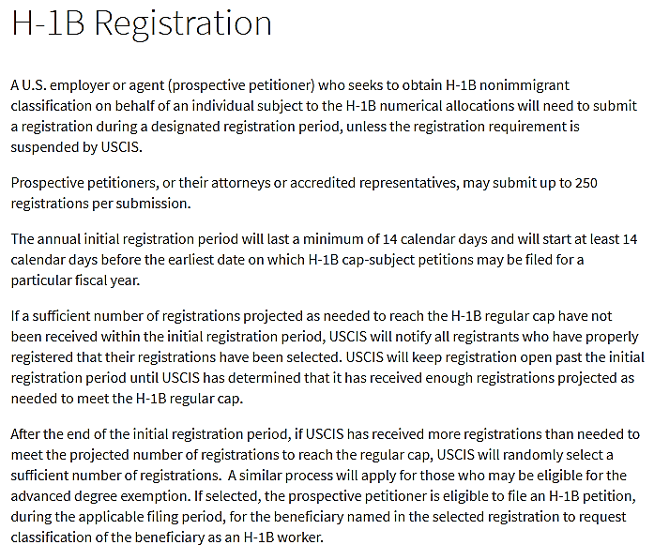
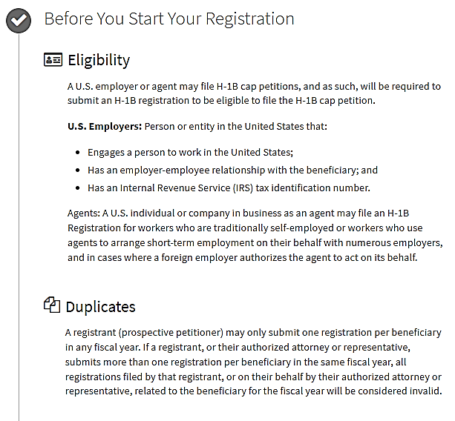
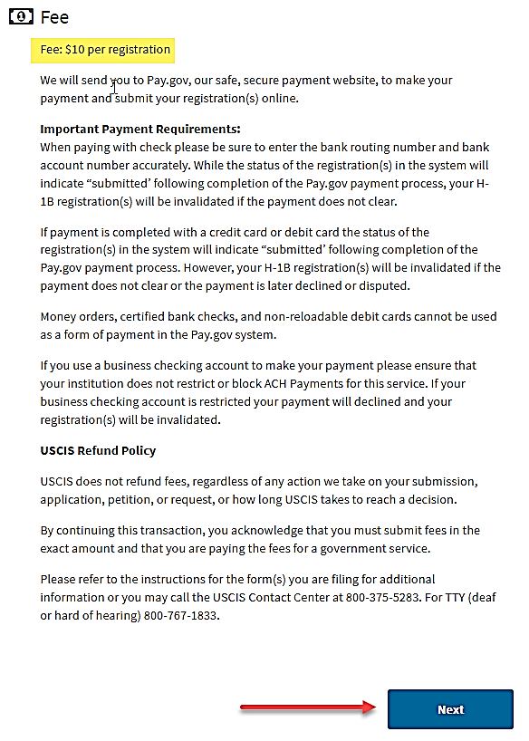
H-1B Registration Overview Page
Notes:
The information you see here is the H-1B Registration Overview page. Please take the time to read it carefully before continuing. This page includes important information about U.S. employers or agents (a/k/a prospective petitioners) who wish to obtain H-1B nonimmigrant classification on behalf of an individual subject to the H-1B numerical allocations.
It also provides information about eligibility, duplicate entries – which we will talk about a few slides from now –the $10 per registration fee, as well as our refund policy.
NEXT SLIDE
**USCIS owns the images

Slide 11
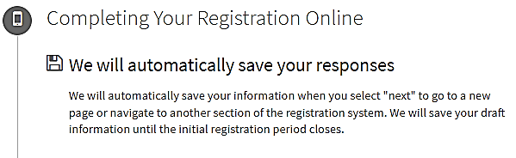
USCIS Online Account
Your entries are saved automatically
Sign out when you want to, you can resume where you left off
You must SUBMIT before noon (ET) on March 17, 2023
Notes:
One of the great benefits of using the USCIS online account is that the system automatically saves your responses. Your work is saved each time you click “next.” Also, you do not have to complete everything in one sitting. You can sign out, and sign back in to resume working. Just remember that you MUST SUBMIT your registrations before noon on March 17, 2023.
Also, a little reminder…there’s an idle time built into the form. If you’re inactive for 15 minutes, the system will log you out and you’ll have to log in again.
NEXT SLIDE
**USCIS owns the images

Slide 12
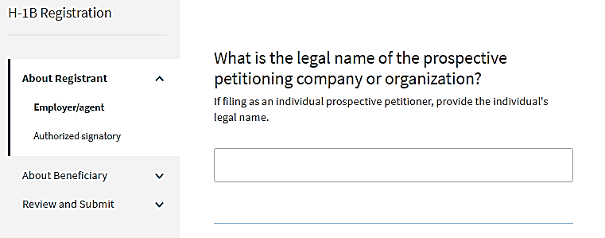
Information About Registrant
This section asks for information about registrant (also called the prospective petitioner):
Legal name
“Doing Business As” name
Employer ID Number
Primary U.S. office address
Notes:
The next four questions ask for the legal name of your company, what is the “doing business as” name, if any, your employer identification number - or SSN or IRS tax number if you’re an individual prospective petitioner, and your primary U.S. office address. You will also need to provide an authorized signatory name, title and contact information.
NEXT SLIDE
**USCIS owns the images

Slide 13
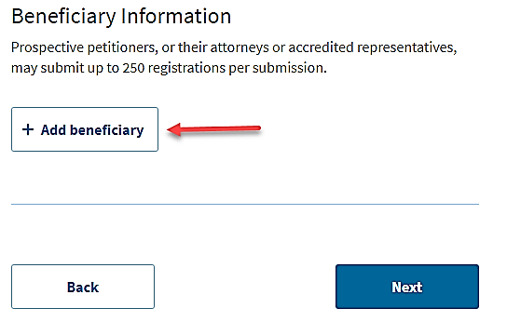
Information About Beneficiary(ies)
Information needed for each prospective beneficiary
Full name
Gender
Date of birth
Country of birth
Country of citizenship
Passport number, if any
Notes:
Next, you will come to the section where you’ll add your beneficiaries.
For each beneficiary, you will need to provide their full name, gender, date of birth, country of birth and citizenship, and passport number if they have one.
You can add up to 250 registrations at one time. If you have a total of more than 250 registrations, you’ll need to submit one batch at a time, make your required payment for the submitted batch, and then start the next batch of registrations.
NEXT SLIDE
**USCIS owns the images

Slide 14
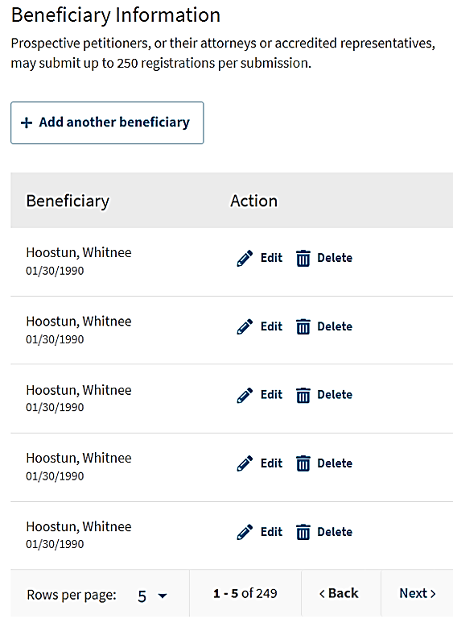
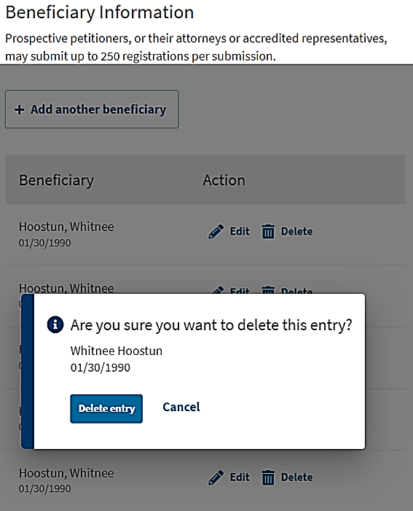
Information About Beneficiary(ies) contd.
Notes:
As you continue to add your prospective beneficiaries, you have the option of expanding your view of draft entries. You can also edit or delete an entry. This may happen, for example, if you identify that you have added the same beneficiary multiple times . If you want to delete an entry, you simply choose “delete” and the system will show you a pop-up alert asking you to confirm. Once again, you can add up to 250 registrations per submission. When you reach 250, you’ll make your payment and then you must create a new submission to add more registrations.
NEXT SLIDE
**USCIS owns the images

Slide 15
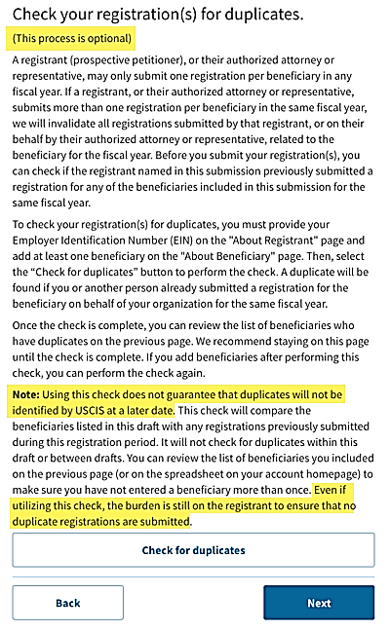
Duplicate Checker
Using the duplicate checker is optional
Ultimate responsibility for duplicates lies with registrant, not USCIS
USCIS may identify additional duplicates later in process
Notes:
Just like last year, we have included duplicate checker functionality. This is another tool you can use to see if you submitted more than one registration for the same person. This tool compares the beneficiaries listed in a draft with any registrations previously submitted by or on behalf of your company during this registration period. It will not check for duplicates within that draft or between drafts.
Keep in mind that this duplicate checker is another resource we have made available to you. Ultimate responsibility for duplicate registrations lies with the registrant, not USCIS. To that end, we strongly recommend you download a .csv file to search for duplicate entries, in addition to using the duplicate checker. Lastly, if more than one person is preparing registrations for your company, such as an attorney or human resources professional, they should coordinate closely to eliminate duplicates before submitting their registrations.
NEXT SLIDE
**USCIS owns the images

Slide 16


Running the Duplicate Checker
Tool compares registrations listed in a draft with registrations already submitted by employer this fiscal year.
Employer must have already submitted (and paid for) a registration for the tool to find duplicates
Tool does not check for duplicates within the current draft or between drafts prepared by different people.
Draft registration, not submitted
Submitted registration
Notes:
When you have entered all your prospective beneficiaries and are ready to run the duplicate checker, please read the information carefully. The system only checks your current draft registrations for duplicate entries against all submitted registrations from the same registrant or company. The system will not check against other registrations in draft status. Submitted registrations are those that have already been submitted to the H-1B registration process and paid for.
NEXT SLIDE
**USCIS owns the images

Slide 17
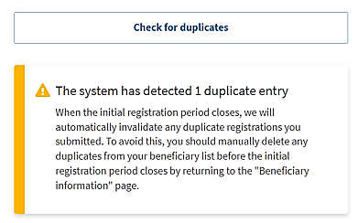
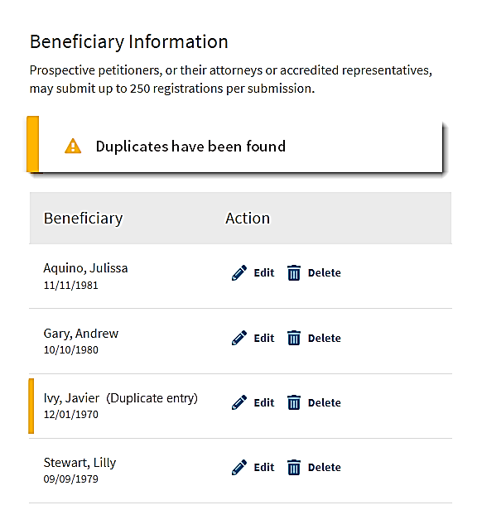
Duplicate Checker contd.
Notes:
When you use the duplicate checker, you may see a yellow alert like the one here on the left.
The image on the right shows which entry is a duplicate by marking it with a yellow alert.
You must manually delete any duplicate entries before the registration period ends on March 17 at noon. If duplicate entries are not removed, all entries for that prospective beneficiary, submitted by that prospective petitioner, will be invalidated.
NEXT SLIDE
**USCIS owns the images

Slide 18
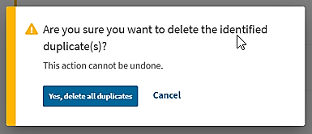
Deleting Duplicates
When the tool identifies a duplicate, and you opt to delete it, this removes the duplicate from the current draft, not in registrations you already submitted.
Notes:
Once you select an entry to be deleted, the system will ask you to confirm that you want to delete all identified duplicates in this draft. Note that this will only delete the duplicate entries in the current draft, it will not delete any registrations that have already been submitted.
NEXT SLIDE
**USCIS owns the images

Slide 19
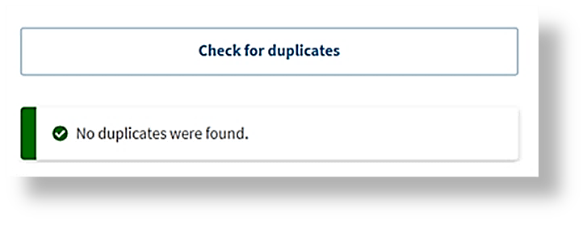
Duplicate Checker contd
If no duplicates are found, you will see this green alert
We encourage you to review all registrations carefully, every time, before and after you submit
Notes:
If there are no duplicates identified, you will see a green alert message like the one on the left and you would simply click “next.” At this point, you are instructed to check your registrations before you submit.
NEXT SLIDE
**USCIS owns the images

Slide 20
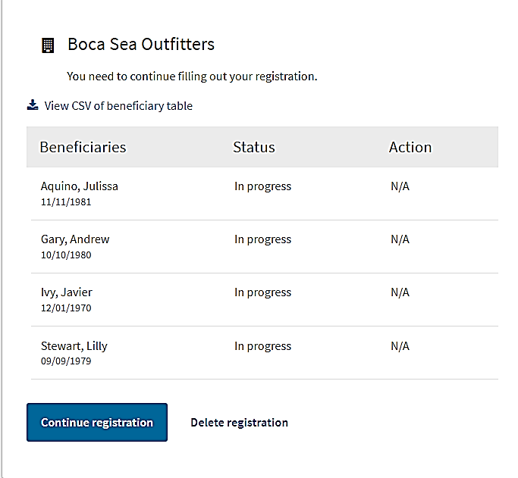
Check For Duplicates With .CSV File
Notes:
As in previous years, you can review your registrations in the .csv file. You can download your draft into a .csv file and review everything from that document. As an Excel document, you can sort your data a variety of ways to ensure all details are correct and that you don’t have duplicates.
The .csv file will contain data for the current fiscal year and includes the registrant’s submitted registrations and draft registrations.
NEXT SLIDE
**USCIS owns the images

Slide 21
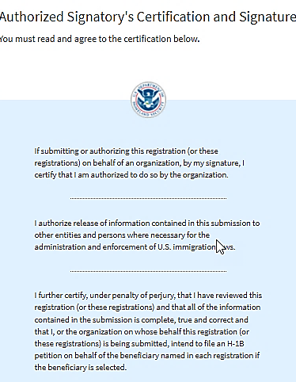
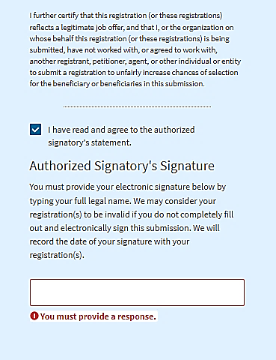
Certification & Signature
Users must attest that submissions are complete and true, and job offers are legitimate
Signature is required
Notes:
H-1B Attestation
When you submit your registration(s), you must attest, under penalty of perjury, that all of the information contained in the submission is complete, true, and correct. The attestation that is required before submission will indicate, “I further certify that this registration (or these registrations) reflects a legitimate job offer and that I, or the organization on whose behalf this registration (or these registrations) is being submitted, have not worked with, or agreed to work with, another registrant, petitioner, agent, or other individual or entity to submit a registration to unfairly increase chances of selection for the beneficiary or beneficiaries in this submission.”
If USCIS finds that this attestation was not true and correct – for example, that a company worked with another entity to submit multiple registrations for the same beneficiary in order to unfairly increase chances of selection for that beneficiary, USCIS will find that registration to not be properly submitted. USCIS also may refer the matter to appropriate federal law enforcement agencies for investigation and further action as appropriate.
Since the registration was not properly submitted, the prospective petitioner would not be eligible to file a petition based on that registration, in accordance with the regulatory language at 8 CFR 214.2(h)(8)(iii)(A)(1). USCIS has denied or revoked FY23 H-1B cap cases based on our investigations that concluded that companies worked together in order to unfairly increase chances of selection for a beneficiary. In these cases, the beneficiary has lost their cap-exempt status. We intend to address this issue for FY24 as well.
The attestation enhances the integrity of the H-1B electronic registration system and combats possible fraud and abuse.
NEXT SLIDE
**USCIS owns the images

Slide 22
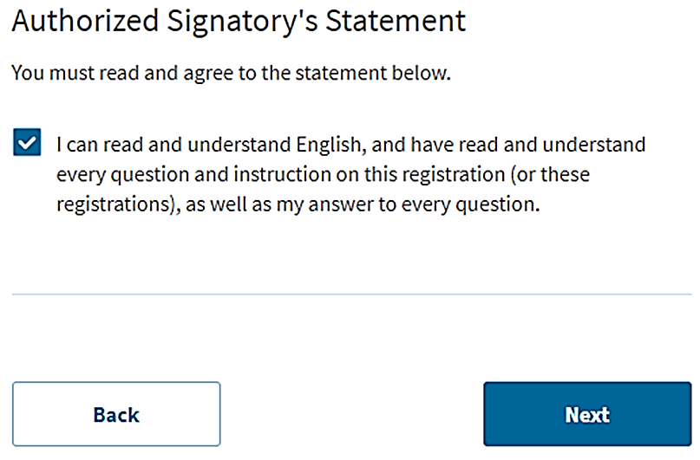
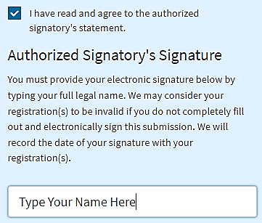
Signature
Notes:
The system will show you a summary of the information you included about your company and all your prospective beneficiaries. You can choose to view a draft snapshot in .pdf format to save to your electronic files and/or you can print it for your records. Then you will sign your form using the Authorized Signatory Statement you see here. In order to sign, you need to type your name in the box provided.
NEXT SLIDE
**USCIS owns the images

Slide 23
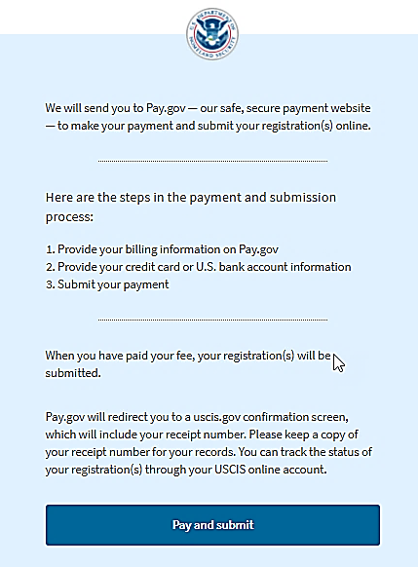
Pay & Submit
Pay.gov is safe and secure
Pay with U.S. credit card or U.S. bank account
Submit
Notes:
During the payment step of the H-1B registration process, you will be routed to a different website called pay.gov, where you will pay the H-1B registration fee.
The required fee for each registration is $10. Each registration is for a single beneficiary, however, up to 250 registrations may be submitted in the same batch submission.
Pay.gov is a government website separate from the USCIS website.
In order to pay for the fee for your registrations, through the Pay.gov site, you must use a U.S. bank account or credit card.
If your payment is rejected due to insufficient funds or you enter the bank account or the credit or debit card number incorrectly, the system will return you to the payment page to correct the error, or to provide an account with sufficient funds.
If your payment fails, your registration(s) will be invalid and your status will change from “submitted” to “invalidated failed payment.” You will also receive a failed payment notice.
If pay.gov experiences issues and is not able to accept your payment, you will see an error message. If this happens, you will need to log back into your USCIS online account and go through these steps to pay at a different time. The online account system will save your registration(s) until you are able to process the payment.
Please remember: to be considered for the initial registration period and associated selection process, payments and the H-1B registration(s) must be properly submitted before the end of the initial registration period on noon March 17.
NEXT SLIDE
**USCIS owns the images

Slide 24
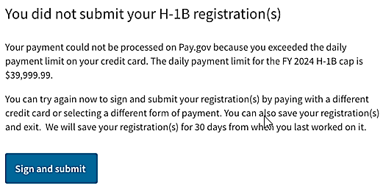
Pay & Submit contd.
Temporary increase in daily credit card transaction limit from $24,999.99 to $39,999.99
Notes:
The U.S. Department of Treasury has approved a temporary increase in the daily credit card transaction limit from $24,999.99 to $39,999.99 per day for the FY 2024 H-1B cap season. This temporary increase is in response to the volume of previous H-1B registrations that exceeded the daily credit card limit.
If you attempt to pay for a submission that would go over the daily credit card transaction limit, you should see the error message above.
NEXT SLIDE
**USCIS owns the images

Slide 25
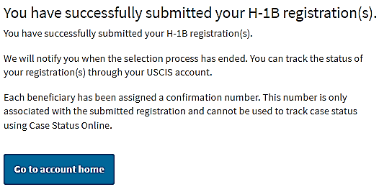
Successful Submission
Notes:
After making payment and submitting your registration successfully, you will see this message. At this point, you can go back to your account to retrieve your records or review your information.
NEXT SLIDE
**USCIS owns the images

Slide 26
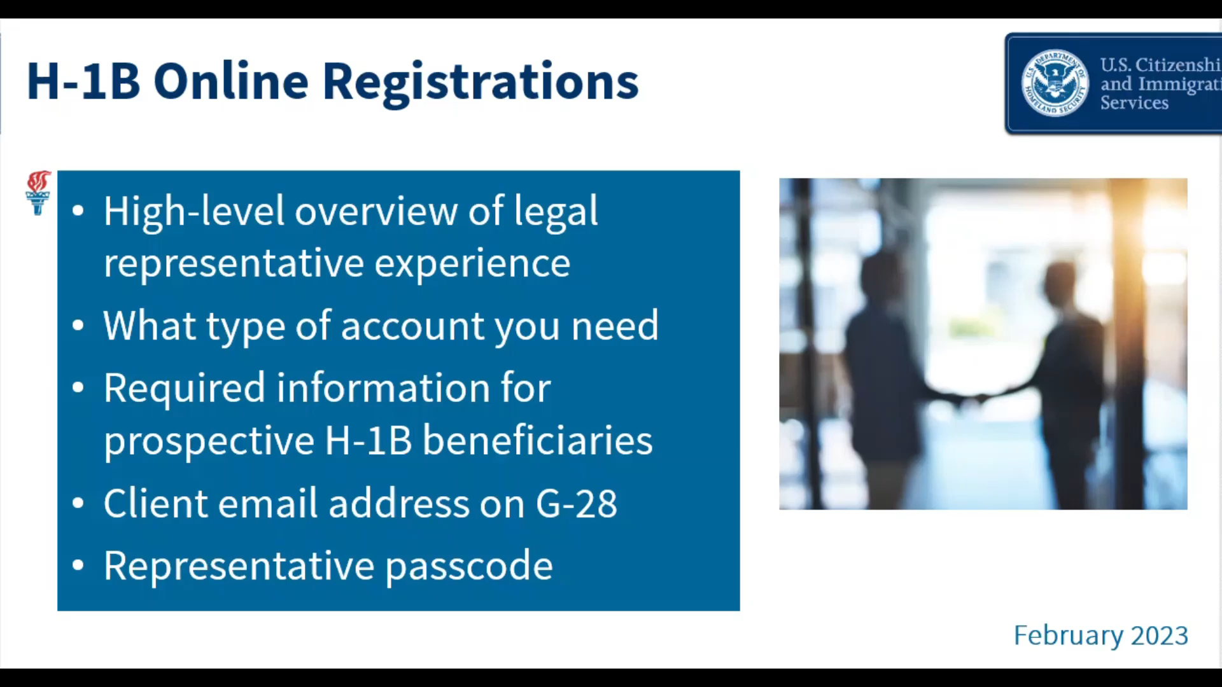
Attorney/Client Electronic Handshake
Notes:
Please CLICK on the slide to play the video.
You would have followed the previous steps if you were submitting a registration as a prospective petitioning company/entity directly. Now, we will talk about the process of submitting a registration as a prospective petitioning company/entity with the assistance of a G-28 attorney or authorized representative.
As you will see, this process does not require the prospective petitioning company/entity to directly enter information on the registration. Rather, the prospective petitioning company/entity should review the G-28 and registration(s) provided to them by their G-28 attorney or authorized representative.
Please CLICK on the slide to play the video.
NEXT SLIDE
**USCIS owns the images

Slide 27
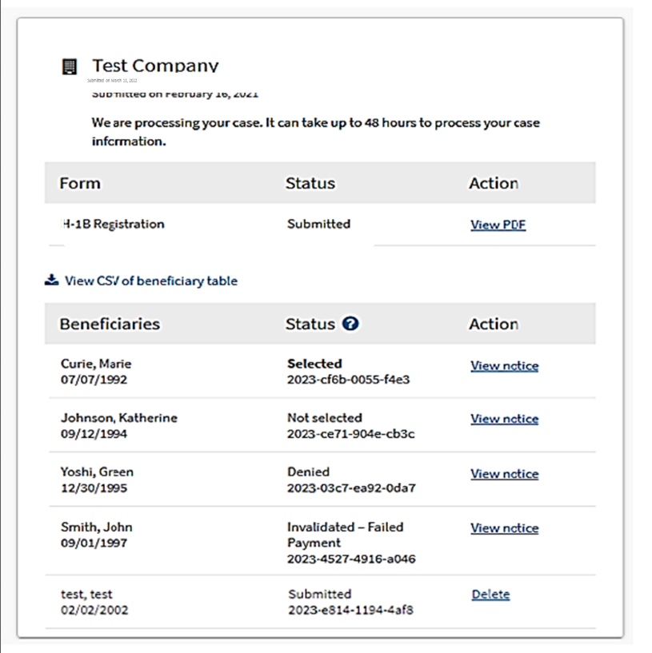
Tracking Registrations and Notices
  You cannot use Case Status Online to check beneficiary confirmation number
  You must check status of H-1B registration(s) through your account
  USCIS will post notices to your account
  You can turn on automatic case notifications
Notes:
Here is an example of what you will see inside your account. This screen lists all your prospective beneficiaries, the current status of each, and action, including notices that will appear once we have issued them.
You will receive an online confirmation once we receive your registration. Each beneficiary will be assigned a confirmation number. This is the unique identifier assigned to each registration for each beneficiary in a submission. This number is only associated with the H-1B registration and cannot be used to track case status using Case Status Online.
You can visit the dashboard of your online account homepage to check the status of registrations.
You will be able to view the registration you submitted for each prospective beneficiary, the status of your submitted registrations and the action taken. We will also post notices when there is activity on your H-1B registrations which you can see in your account. This will include a hyperlink to see each notice regarding the action we have taken on each beneficiary. You can save the notice electronically and/or print each notice.
In your account profile, you can sign up to receive automatic notification via email or text message, so you will know when we have added a notice to your account.
Once again: you will be able to log into your USCIS account to see the status updates.
“Submitted” registrations will remain in the system, and available for possible selection, until USCIS has determined that it has received sufficient petitions to meet the H-1B regular cap and advanced degree exemption. So, the “Not Selected” notification will not show for any registration until later.
NEXT SLIDE
**USCIS owns the images

Slide 28
Duplicates After Submission
If you find duplicates after submission…
And initial registration period is still open (before noon on March 17)
  You can go into your account and delete extra submissions until there is only one registration per beneficiary. We do not refund the $10 fee you paid.
And initial registration period has closed (after noon on March 17)
  There is no way to correct this error. We will remove all registrations for that particular beneficiary submitted by that prospective petitioner. We do not refund the $10 fee you paid.
Notes:
If you discover you or your representative submitted more than one registration for the same person and the initial registration period is still open (before noon Eastern on March 17, 2023), you can go into your account and delete the extra submission(s) until there is only one registration for the beneficiary. We do not refund the $10 fee if you delete a duplicate registration after submission.
If you discover that you or your representative submitted more than one registration for the same person and the initial registration period has closed (after noon Eastern on March 17, 2023), there is no way to correct this error. We will remove all registrations submitted for the beneficiary by, or on behalf of, that prospective petitioner from the selection process. We do not refund the $10 fee for a removed registration.
Remember, if you submit more than one registration per beneficiary in the same fiscal year, all registrations submitted by your company or entity for this particular beneficiary will be considered invalid and removed from the selection process.
NEXT SLIDE
**USCIS owns the images

Slide 29
Registration Period Timeline Reminders
Feb. 21, 12 p.m. (Eastern): New H-1B registrant accounts can be created
March 1, 12 p.m. (Eastern): H-1B registration period opens, registrations can be created/submitted
March 17, 12 p.m. (Eastern): H-1B registration period closes, no more registrations can be submitted
March 31: USCIS intends to issue selection notifications through USCIS online account by this date
April 1: Earliest date that FY24 H-1B cap-subject petitions can be submitted
Notes:
Once again, if you want to create an H-1B registrant account, you can do that now. And the registration period opens on March 1 at noon eastern and closes on March 17 at noon eastern time.
NEXT SLIDE
**Image obtained from bing.com images, using the filter “Free to modify, share, and use commercially”

Slide 30
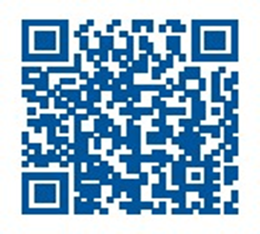
H-1B Electronic Registration Helpful Links & Resources
Account sign up/login page:
my.uscis.gov or www.uscis.gov
Help with account creation:
uscis.gov/file-online
Technical support, including:
Password resets
Account lockouts
Update your verification code delivery method
my.uscis.gov/account/needhelp
H-1B Electronic Registration Process Webpage: uscis.gov/h-1b
For help with H-1B Electronic Registration inquiries: uscisfeedback@uscis.dhs.gov
**Put “H-1B Electronic Registration” in the Subject line of the email.
To provide feedback on today’s engagement, please email Public.Engagement@uscis.dhs.gov
To access a copy of this presentation:
Electronic Reading Room
uscis.gov/records/electronic-reading-room
Sign up for updates from the Public Engagement Division
Notes:
Here are some helpful resources and links.
You can log into your myUSCIS account at any time to view status updates.
For technical support and password resets, please use the need help web form, which is the third link shown here.
For help with H-1B Electronic Registration inquiries, email us at: uscisfeedback@uscis.gov. Be sure to put "H1B Electronic Registration“ in the subject line of the email.
For more information on the H-1B electronic registration process and implementation, visit the H-1B webpage on uscis.gov.
NEXT SLIDE
**USCIS owns the images

Slide 31
31
Questions?
Thank you!
Notes:
We are very excited about our online services. We’re striving to improve these tools and resources every day and your feedback is an invaluable part of that process. We encourage you to please send feedback to us at public.engagement@uscis.dhs.gov.
END

Slide 32
Disclaimer
This webinar material is intended solely as informational. It is not intended to, does not, and may not be relied upon to create or confer any right(s) or benefits(s), substantive or procedural, enforceable at law by any individual or other party in benefit applications before DHS, in removal proceedings, in litigation with the United States, or in any other form or manner. This webinar material does not have the force of law, or of a DHS directive.

Slide 33
About this Presentation
Author: USCIS
Date of last revision: Feb. 28, 2023. This presentation is current only as of the date of last revision.
This presentation contains no sensitive Personally Identifiable Information (PII).
Any references in documents or text, with the exception of case law, relate to fictitious individuals.

Slide 34
Dissemination
This presentation may not be reproduced or further disseminated without the express written consent of USCIS.
Please contact Public.Engagement@uscis.dhs.gov for additional information.

